Slide 1
DCC Graduate Employment Data
From 2022 DCC Alumni Survey

Slide 2
2022 Survey Details
38 Graduates in 2022
36 Survey Responses
95% Response Rate
Main Survey Opened April 27, 2022
An addendum to that survey was opened May 7 to clarify some data.
28 responded to the addendum survey (2 questions) which was a 73% response.

Slide 3
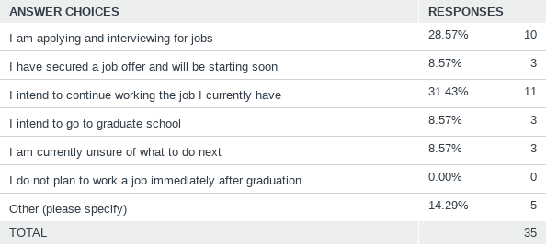
40% of the class of 2022 have secured a job or intend to keep the one they have now
28% are actively looking for jobs
Where are you in your plans for after graduation?
Answered: 35 Skipped: 1

Slide 4
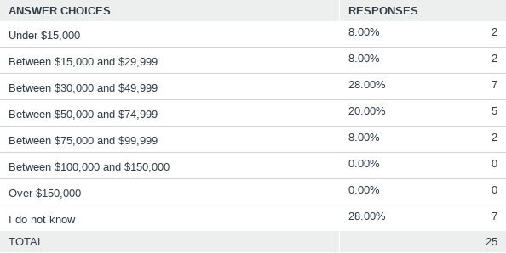
Of those who knew their annual salary, 39% expect to make between $30,000 and $50,000 annually
And 39% expect to make over $50,000 annually
If you know your annual salary range, what is it? (optional)
Answered: 25 Skipped: 11

Slide 5
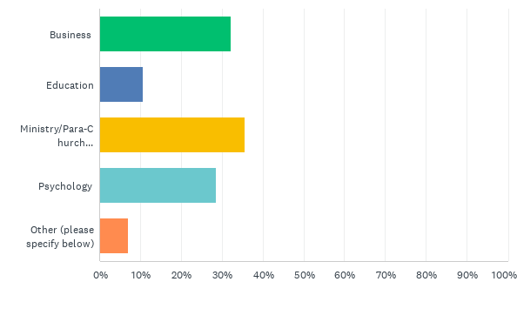
I plan to go into this field (Check all that apply)
36% expect to serve in a Ministry of some kind
A Ministry area is the largest field chosen
Answered: 28 Skipped: 0
Answered: 28 Skipped: 0

Slide 6
Do you plan to go to graduate school?
22% plan to go to graduate school immediately
43% hope to go to graduate school when the time is right
Answered: 28 Skipped: 0

