Slide 1
5 Ways To Have An Impactful and Effective Online Broadcast

Slide 2
Create the culture for your experience and stick with it.
1
Acknowledge everyone on the broadcast stream by name
Ask what you can pray for, and how you can pray for each person
What you create, people will expect
Pre-show/post-show – it’s your new church lobby
When you consistently greet people by name, they ask when they will get a shout-out
Create an experience that allows people to feel like they are in the room and you are talking/leading them directly
Don’t shy away from calling people to do something: type in the chat, share, make-a-decision, etc.
Keep the engagement with the experience going after the broadcast (social media recaps, sermon clips, quotes, etc.)

Slide 3
Consistent chat hosts are key to building relationships and connection.
2
Have chat host leaders pray with people, answer questions, post links, and drive conversation and participation
This helps drive your online culture to be a friendly, helpful, and interactive experience.
LIVE prayer has become a cornerstone for relational equity
Follow-up is key to first-time guests
Designate a staff member or chat host leader to follow up with those who ask for specific prayer requests (as needed)

Slide 4
LIVE elements in your broadcast enhance the viewer experience.
3
When viewers know your broadcast is LIVE, they tend to engage more
You can’t welcome people by name and where they are from enough
Acknowledging the different ways people are viewing grabs people’s attention:
“You may be watching in your living room, in the kitchen, in your car, on your phone…” It emphasizes that however they are watching is okay
Use the LIVE elements to tie in anything that is pre-recorded. If you do this well, it will be hard for the viewer to tell what’s LIVE and what’s not

Slide 5
Excellence is Essential. .
4
Stay clear from the verbiage that’s says: “It’s just online, it will be fine.”
Plan your experience through the lens of: “This works in the room, but does it translate well online?”
It’s important that those on camera have more energy than normal and smile!
If no one is in the room, be intentional in planning the experience to focus on the online audience
Your broadcast will be online for people to view at any time, even a later date, so refrain from ‘Good mornings’, ‘Good evenings’ or specific days/dates.

Slide 6
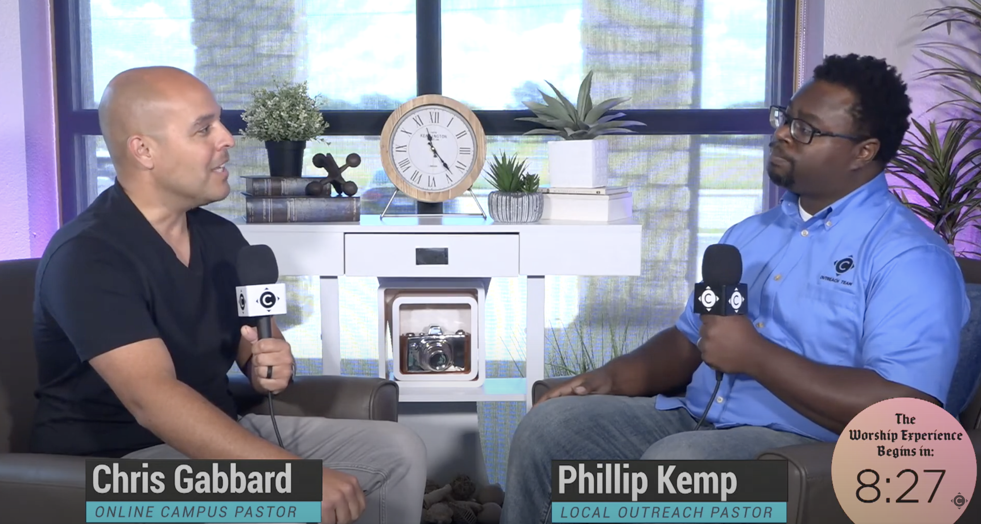
Be creative with your backdrops and environments. .
5
The more artificial potted plants you have the better ☺
Salvations increase when greenery is present!

